Slide 1
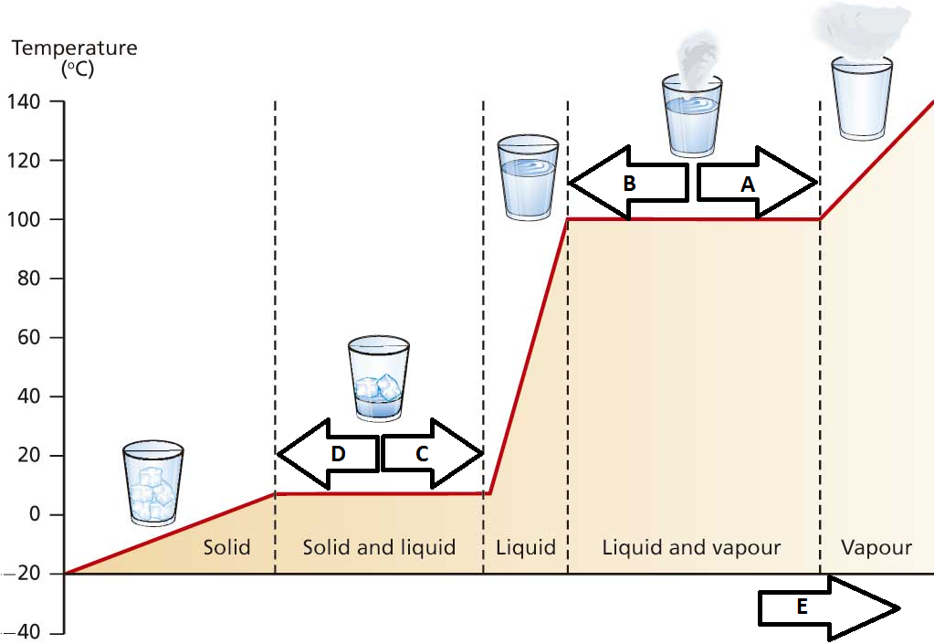
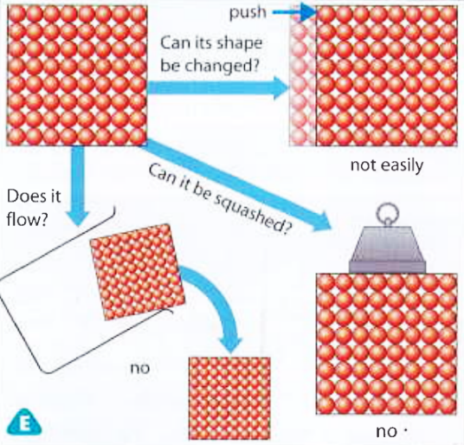
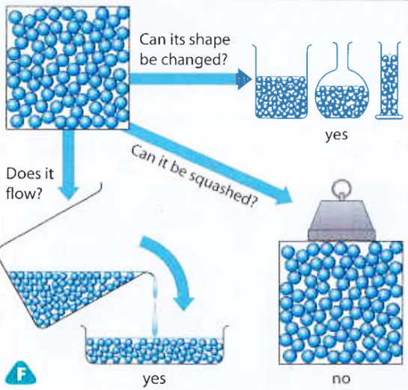
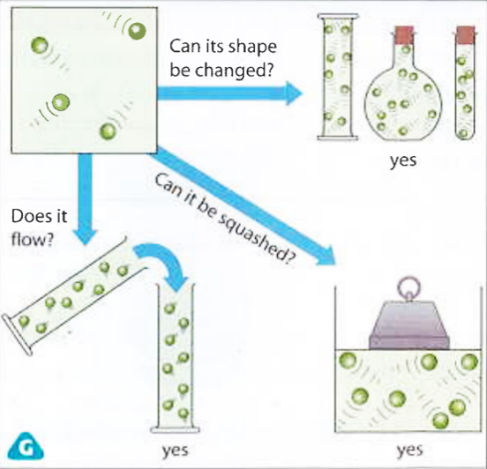
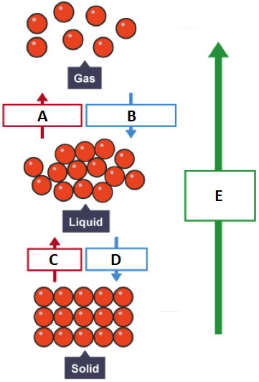
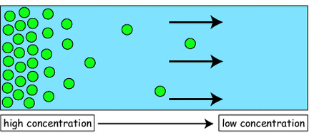
7CP - Particles and separations
Solids | Liquids | Gases
1. Properties
Particle arrangement
Regular pattern Particles close together | Random arrangement Particles close together | Random arrangement Particles far apart
4. Particle motion
Particle vibrate around a fixed position | Particles are free to slide over each other | Particles are free to move in all directions
2. Changes of state
Evaporation Condensation Melting Freezing Increasing internal energy
5. Key words and definitions
Dissolve | Becomes part of a liquid
Solvent | Liquid in which something dissolves
Solute | The solid substance to be dissolved
Solution | A solvent containing a dissolved solute
Soluble | Something that does dissolve
Mixture | A solvent containing solid particles that do not dissolve
6. Diffusion
The random movement of a substance from an area of high concentration to an area of low concentration
Separation methods
Distillation | Evaporation followed by condensation of a solvent from a solution
Filtration | Separation of insoluble solute particles from a mixture
Chroma-tography | Separation of dissolved solute particles. The most soluble solutes travel the furthest.
8. Water, key temperatures
1.Freezing/melting point: |  | 0°C
2.Dew/boiling point: |  | 100°C

