Slide 1
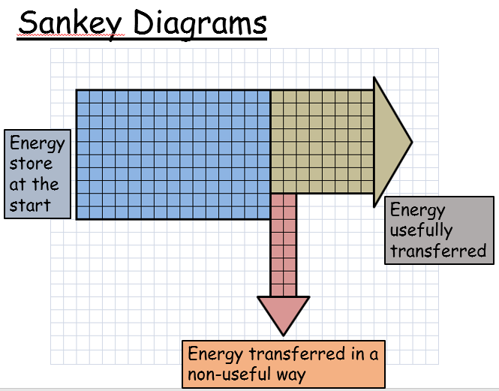
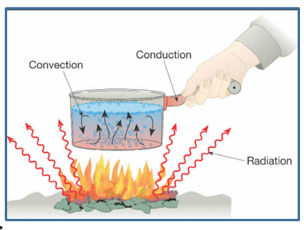
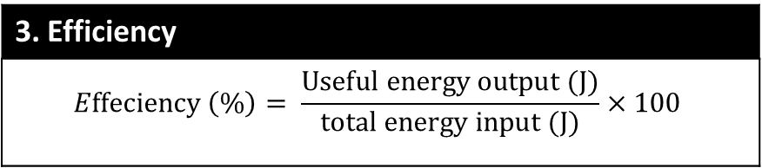
1. Energy Stores
Energy Store | Definition | Example
Kinetic | Energy of a moving object | A moving car.
Gravitational Potential | Energy stored by being above ground level | A diver standing on a diving board.
Chemical | Energy stored in the bonds between particles | A burger and fries.
Electrostatic | Energy stored in charged particles | A build up of static electricity.
Thermal | Energy stored in an object that is hot | A hot cup of coffee.
Elastic Potential | Energy stored in an object that is stretched or compressed. | A stretched bow string.
Magnetic | Energy stored in magnetic fields | A magnet
Nuclear | Energy stored in atoms | Nuclear power
7PE Energy Knowledge Organizer
3. Efficiency
$$Effeciency \left(\%\right)= \frac{Useful energy output (J)}{total energy input (J)}×100$$
4. Ways of transferring Thermal Energy
Method | Works in | Caused by
Conduction | Solids | Particles vibrating into each other.
Convection | Liquids & Gases | Expansion of the space between particles reducing in density.
Radiation | All materials & a Vacuum | Infra Red (IR) radiation being emitted.
Insulation | All materials & a Vacuum | Stops thermal energy being transferred
2. Pathways
Heating | Mechanical Transfer | Electric Current | Radiation
Energy moves from a hot object to a cooler one. | By use of a machine or tool or by an energy wave. E.g. Sound and seismic waves | Charged particles called electrons move around a circuit | All forms of electro-magnetic waves. Such as light, infra red, ultra violet.

Slide 2
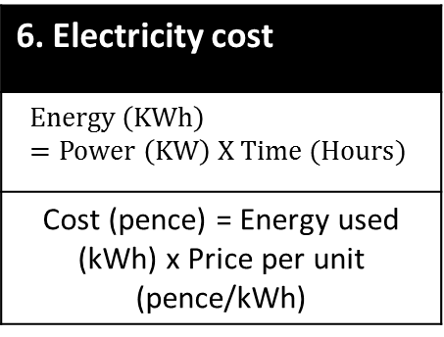
7. Energy Resources
Energy Resource | Renewable | Advantages | Disadvantages
Fossil Fuels | No | Low cost, easily transportable. | Produce large amounts of pollution.
Nuclear | No | Generates a lot of electricity. | Expensive. Produces dangerous by products.
Solar | Yes | No fuel costs or pollution. | Expensive to set up. Doesn’t work at night.
Wave | Yes | No fuel costs. Reliable and easily accessible. | Can damage marine ecosystems.
Tidal | Yes | No fuel costs or pollution. Predictable. | Can damage marine ecosystems.
Wind | Yes | No fuel costs or pollution. | Not always reliable, noisy.
Geothermal | Yes | No fuel costs or pollution. | Very few areas where it is accessible.
Biomass | Yes | Low cost, readily available. | Large scale land use requiring irrigation.
Hydro-electric | Yes | No fuel costs, reliable and easily controlled. | Environmental impact during construction.
5. Power
Power (W) | Energy ÷ Time | E ÷ t
Energy (J) | Power x Time | P x t
Time (s) | Energy ÷ Power | E ÷ P
6. Electricity cost
$$Energy \left(KWh\right)=Power \left(KW\right) X Time (Hours)$$
Cost (pence) = Energy used (kWh) x Price per unit (pence/kWh)
8. Keywords
Keyword | Meaning
Power | is the rate of energy transfer in Joules per second (called Watts)
Fuel | A substance that is burnt to release the energy it contains.
Energy Resource | A source of energy that can be used to generate electricity.
Law of Conservation | Energy cannot be created or destroyed, only transformed.
Joule (J) | The unit of energy.
Watt (W) | The unit of power.

Slide 3
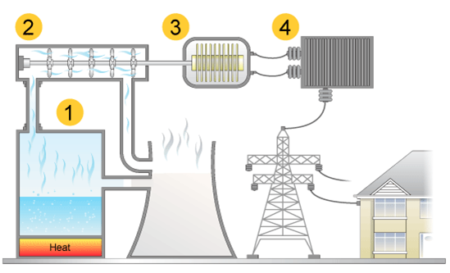
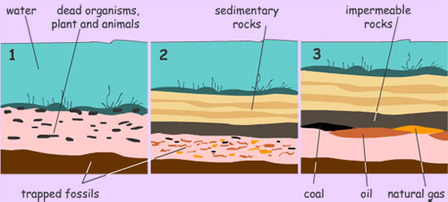
9. Fossil fuels
Fuel | How its made
Coal | Dead trees and plants become buried underground, over millions of years the pressure underground causes these to form coal.
Oil and Gas | When small sea animals die they become encased in sand, this all gets buried under the sea. Over millions of years the sad becomes rock and the small sea animals form crude oil and natural gas.
10. Generating electricity
1 | Energy is transferred from the chemical store in the fuel to the water
2 | The steam produces is blasted at turbines, which increases their kinetic store – they turn.
3 | The turbines run a generator to generate electricity
4 | The electricity is carried to our homes via the national grid

