Slide 1
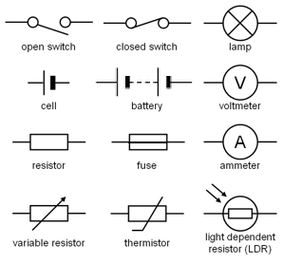
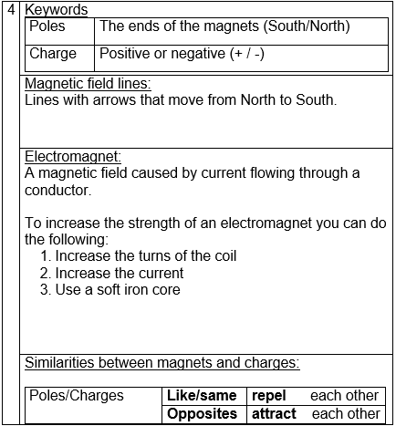
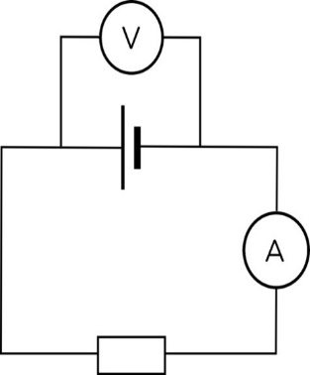
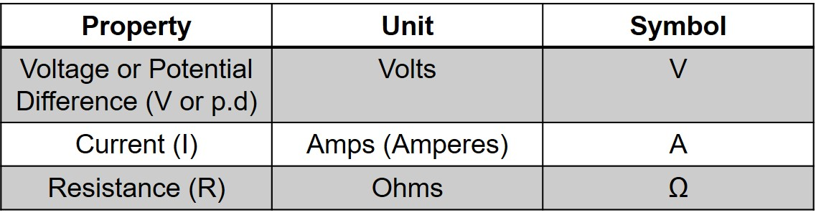
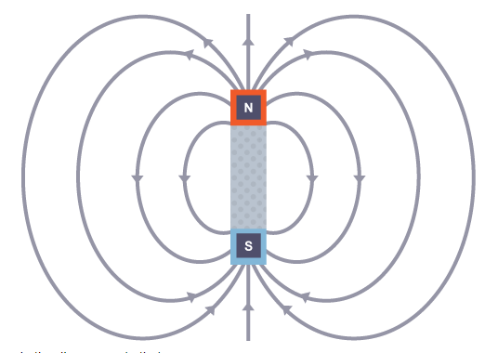
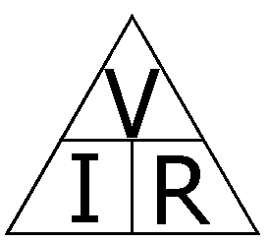
8 PE ELECTRICITY AND MAGNETISM
1
1 | Open switch | 7 | Resistor
2 | Closed switch | 8 | Fuse
3 | Bulb | 9 | Ammeter
4 | Cell | 10 | Variable Resistor
5 | Battery | 11 | Thermistor
6 | Voltmeter | 12 | Light Dependent Resistor
1.
2.
3.
4.
5.
6.
7.
8.
9.
10.
11.
12.
2 | Series | Parallel
Components | connected on one loop | connected by separate loops
Current | same everywhere on circuit | shared evenly between loops
Voltage | Shared between components | Same everywhere
Unit
Conductor: allows charge to flow through it. Does not hold charge.eg: ALL metals and graphite.
Insulator: does not allow current to flow. Holds charge. Eg: Wood, plastic, glass, rubber.

