Slide 1
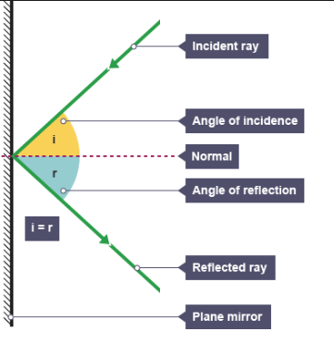
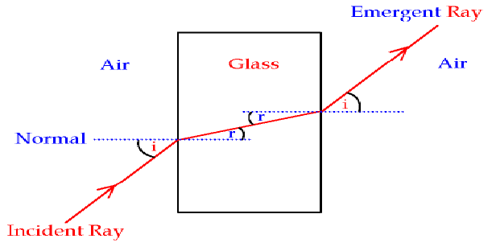
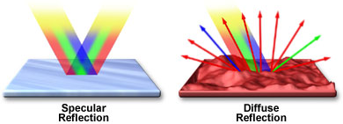
8PL Light and Space
1. Light Keywords
1 | Reflection | Light bounces off surface
2 | Refraction | Light is bends as it enters and leaves
3 | Primary colours | Red/Blue/Green makes all colours
4 | Eyes | Senses the light we see
5 | Filters | Absorbs light of the same colour
6 | Transmitted/Emitted | Light that is given out
7 | Absorbed | Light that is taken
8 | Scattered | Light that is spread when it reflects
9 | Boundary | A place where lights bounces off or bends
10 | Secondary light | When primary light mixes
2. Law of reflection
1 | Incident ray | A beam of light that comes from the light source.
2 | Incidence angle | The angle made between the incident ray to the normal line
3 | Normal line | This line is 90 degrees to the mirror
4 | Reflected angle | The angle made between the reflected ray to the normal line
5 | Reflected ray | A beam of light that leaves the mirror
6 | Mirror | Light reflective surface
7 | Law of reflection | Angle of incident = angle of reflection
6 Law of refraction
1 | Refracted ray | A beam of light that leaves the glass block
2 | Incident ray | A beam of light that comes from the light source.
3 | Normal line | This line is 90 degrees to the surface
4 | Medium 1 | Air
5 | Medium 2 | Glass block
6 | Incidence angle | The angle made between the incident ray to the normal line
7 | Refraction angle | The angle made between the refracted ray to the normal line
8 | Law of refraction | The beam will bend towards the normal line as it goes from a less dense medium to a more dense medium
1
1
2
4
5
4
3
4. Types of reflection
4
1. Specular reflection is what you see in a mirror – the image is not distorted
2. Diffuse reflection is what happens from most materials – the light is reflected but the image is not preserved
3
6
7
5
6
2
7

Slide 2
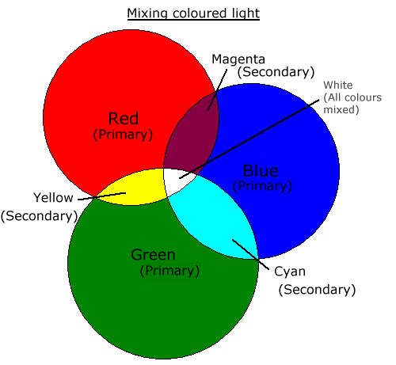
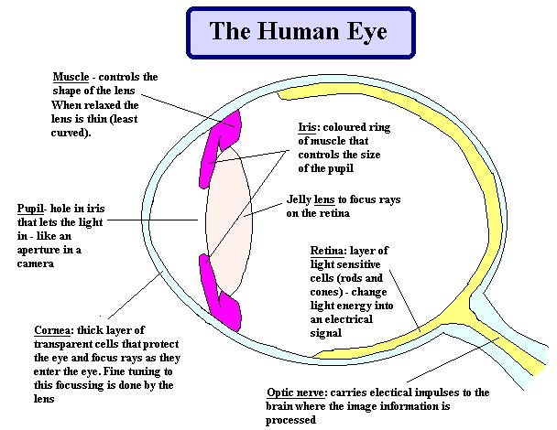
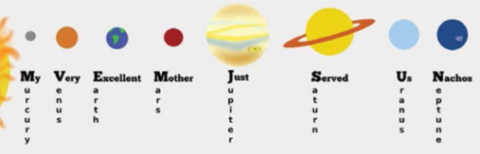
5. The eye
1 | Muscle | Controls shape of the lens. Relaxes makes the lens fat.
2 | Pupil | Hole that light in like a camera aperture
3 | Cornea | Transparent front of the eye
4 | Iris | Coloured muscle that controls the amount of light entering the eye
5 | Jelly lens | Can change shape to focus light onto the retina
6 | Retina | Layer of light sensitives on the back of the eye
7 | Optic nerve | Carries the electrical signals to the brain
6. Colours
Primary colours | Secondary Colours
Red | Magenta
Green | Cyan
Blue | Yellow
7. Space
Gravity | Non-contact force of attraction between masses. The larger the mass the larger the pull of gravity
Light | Travels in straight lines
Light | Travels very fast – 300,000,000 m/s
Galaxies | Contains many solar system
1
8. Solar system
1 | Mercury | My
2 | Venus | Very
3 | Earth | Easy
4 | Mars | Method
5 | Jupiter | Just
6 | Saturn | Speeds
7 | Uranus | Up
8 | Neptune | Naming
4
2
5
6
3
7
1.
2.
3.
4.
5.
6.
7.
6.

Slide 3
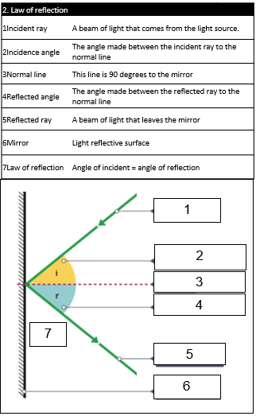
Name:
/8

