Slide 1
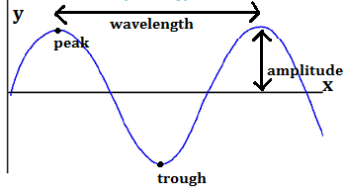
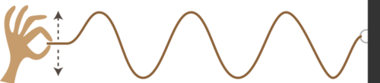
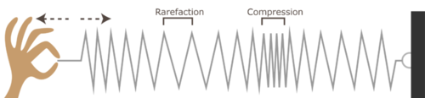
9PS Sound Waves
2.
1.
Comparing waves: | Light wave | Mechanical wave
Type of wave | Transverse | Longitudinal
Can they travel through a vacuum? | Yes | No. Mechanical waves can only pass through a solid, liquid or gas
Can they be reflected? | Yes. By smooth shiny surfaces | Yes. By smooth surfaces
Can they be absorbed? | Yes. By dark surfaces | Yes. Rough surfaces absorb sound
Can superposition occur? | Yes | Yes
Keyword | Definition
Transverse wave | A wave where the vibration is perpendicular to the direction of travel
Longitudinal wave | A wave where the vibrations are parallel to the direction of travel
Mechanical wave | A vibration that travels through a substance (e.g. sound)
Frequency | The number of wave fronts passing a fixed point every second (measured in Hz)
Ultrasound | Sound above 20KHz
Superposition | When two waves meet and affect each other
Reflection | When waves bounce off a surface
Echo | Reflection of sound that can be heard
3.
Uses of ultrasound
Use | How it works
Cleaning jewellery | The vibrations of the wave shake the dirt lose
Scanning the human body | The waves are partially reflected at different tissue boundaries
Industrial imaging | The waves can detect flaws in metal castings as they are partially reflected by cracks
Physiotherapy | Energy from the wave is absorbed by body tissue and relieves pain
5.
6.
7.
4. Labelling a wave
Speed of sound
Sound travels faster through liquids and solids than it does through a gas because the particles in a gas are further apart
Humans can hear sound in the 20Hz – 20KHz range.
Dogs can hear up to 50Hz
Sound waves are produced by all vibrating objects. Loudspeakers work by converting electrical energy into kinetic energy. This moves the cone which creates the sound waves.
Transverse wave
Substance | Speed of sound
Air | 343 m/s
Water | 1493 m/s
Steel | 5130 m/s
Sound waves
Longitudinal wave
Cone
Speaker

